Slide 1


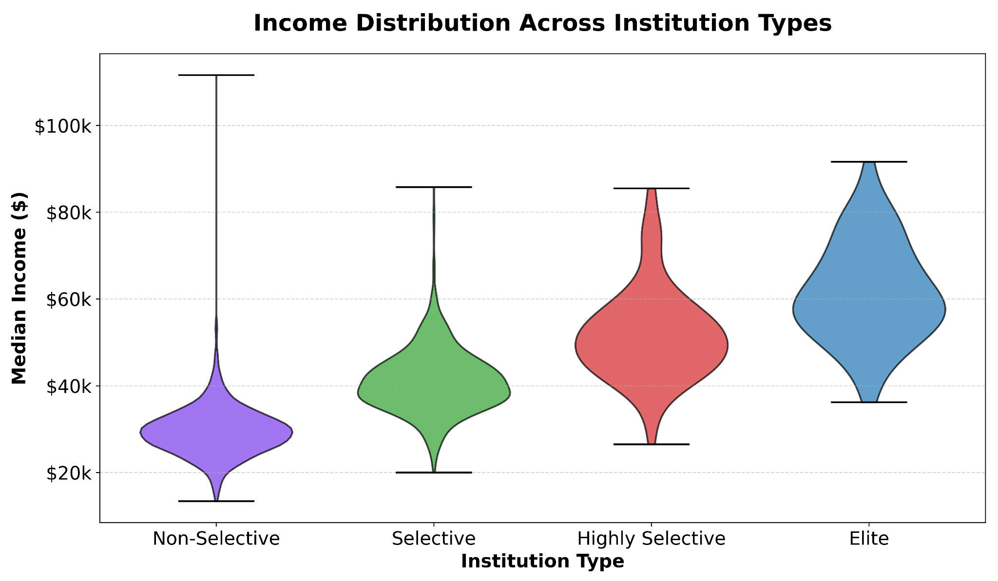
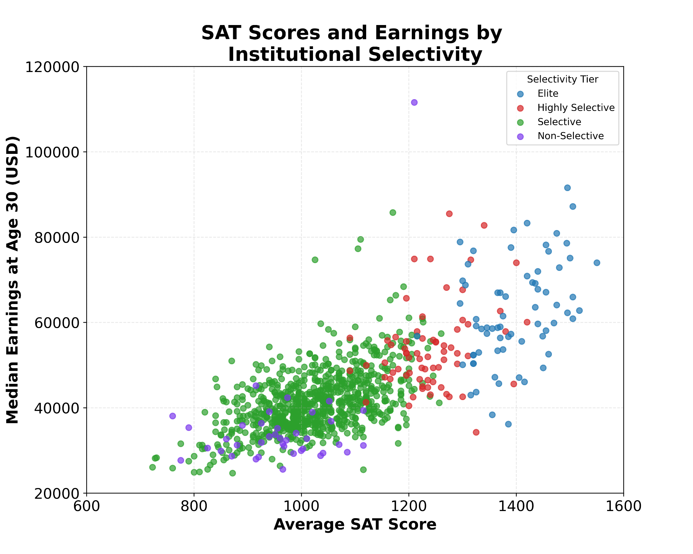
The Big-Fish-Little-Pond Effect: How Institutional Prestige
Shapes Student Outcomes
Mikel Good
CMSE 402: Introduction to Data Visualization Principles and Techniques
Introduction
Results
Discussion
Elite institutions have been the highlight of American society, producing top-tier entrepreneurs, politicians, and innovators. However, they may also be harmful to students who don’t fit the typical mold. In his book titled “David and Goliath,” Malcolm Gladwell references a term known as “relative deprivation” (Gladwell, 2013). This phrase explains that a key factor in success for individuals is their surrounding environment.
This study examines this phenomenon, referred to as the “Big-Fish-Little-Pond Effect” (BF-LPE). The more elite an educational institution is, the less confident those that aren’t in the top percentile feel about their own abilities. These same students would very likely perform much better at institutions less prestigious. The following sections will examine this in more detail, as well as compare the long-term outcomes of this scenario.
This analysis affirms the BF-LPE theory, as presented by Malcolm Gladwell. While the median income trends upward with increased institutional selectivity, these outcomes were not equal for all students. Elite institutions provide Individuals at more prestigious institutions who perform below average academically tend to have lower long-term success compared to high-achieving students at less prestigious universities, as measured by their median income 10 years later. This aligns with Gladwell’s argument using a different metric — number of publications. The comparison and data showed that the graduates in the 99th percentile of non-top 30 institutions had greater rates of publication than those in the 80th percentile and below of elite universities.
Median earnings vary by institution type. Students at elite schools tend to earn more in the long term, but not all students benefit equally.
Median earnings are notably lower for non-selective schools compared
A positive correlation exists between SAT scores and earnings. However there is much overlap in earnings at the bottom end of the more prestigious schools distribution and the top end of the less prestigious schools distribution.
Institutional characteristics vary across institution type, but once again there is overlap.
Conclusion
While students at elite institutions earn more on average, there is more to the story than what is observed at the surface. The long-term success of an individual depends on a multitude of factors, and of them one of great importance is their self-concept. The same qualities that prestigious universities are founded on, such as selectivity and academic rigor, are those that cause students on the lower end of the academic distribution to struggle. Because of this, when choosing between institutions, students may benefit from considering where they’re more likely to thrive, not solely those of greatest prestige.
Data & Methods
References
The data for this research was obtained from Opportunity Insights, a team of researchers based at Harvard University that analyzes data on a variety of topics. The content of interest for this investigation combines data from the Department of Education’s IPEDS and the College Scorecard databases. Within this dataset, the metrics analyzed were average SAT scores, rejection rate, college spending, faculty salary, graduation rate, and median earnings.
Gladwell, M. (2024). David and Goliath: Underdogs, misfits, and the Art of Battling Giants. Back Bay Books / Little, Brown and Company.
Opportunity Insights. (n.d.). College-level characteristics. Harvard University. https://opportunityinsights.org/data/

